Slide 1
Homework
Read news in English from China Daily or other websites. Share at least one piece with your friend or in front of the whole class each class.
Preview Unit 1.
Warming up questions on page 2; Reading activities exercise 1 and 2 from page 2-3: There will be an informal test about them.

Slide 2
1. Any news from you?
2. My news
3. Homework checking

Slide 3
1. Any news from you?

Slide 4
Homework Checking
Prepare an excise book.
Write down the answers.

Slide 5
I. Newspaper Parts
Directions: Write the names of these five parts marked 1-5. Refer to “Introduction to Newspapers Quiz”.
________________
________________
________________
________________
________________

Slide 6
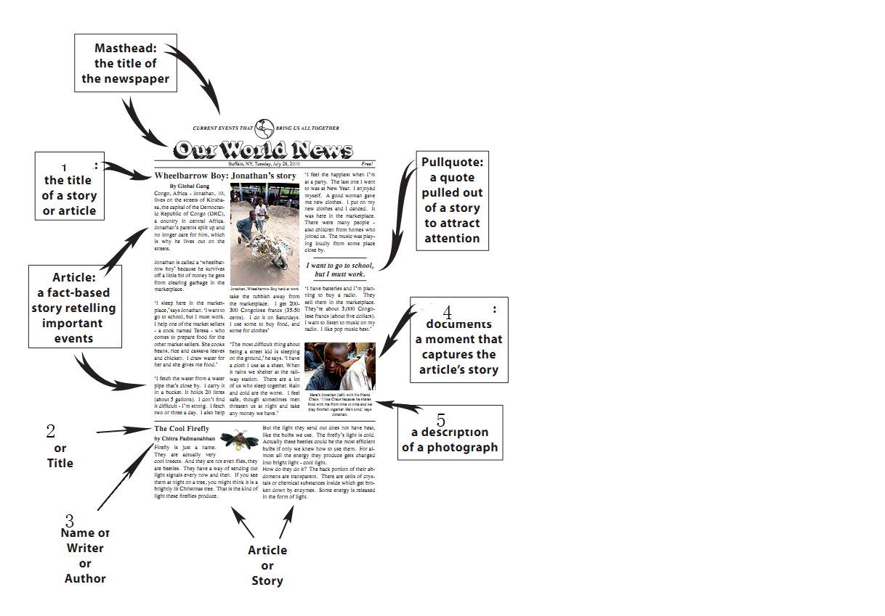

Slide 7
II. Directions: Write the number of five American media. (只写序号)
American: _______________________
1. Fortune 2. Reuters
3. BBC 4. The Wall Street Journal
5. The Guardian 6. Time
7. The Times 8. CNN
9. CRI 10. AP

Slide 8
Part III Some common phrases
Translate the following Chinese phrases into English.
环境保护
温室效应
全球变暖
可持续发展
生态平衡
污染源

Slide 9
Part IV Structure of the news body
Number all the paragraphs and divide the article to three parts from the third paragraph and summarize their main idea.
Part 1: ______ paragraph ( 3 to ___)
Part 2: ______ paragraph (___ to ___)
Part 3: ______ paragraph (___ to _15__)

Slide 10
Keys
I. Newspaper Parts
Directions: Write the names of these five parts marked 1-5. Refer to “Introduction to Newspapers Quiz”. (5*5=25 points)
Headline
Headline
Byline
Photo/wire photo/ photograph
Caption/cutlline

Slide 11
Keys
II. Directions: Write the number of five American media. (只写序号)
American: _1 4 6 8 10__ (5*5=25 points)
1. Fortune 2. Reuters
3. BBC 4. The Wall Street Journal
5. The Guardian 6. Time
7. The Times 8. CNN
9. CRI 10. AP

Slide 12
Keys
III. Translate the following Chinese phrases into English. (6*5=30 points)
环境保护: environmental protection
温室效应: Green House effect
全球变暖: global warming
可持续发展: sustainable development
生态平衡: ecological balance
污染源: pollution sources (sources of pollution)

Slide 13
Keys
IV. Number all the paragraphs and divide the article to three parts from the third paragraph and summarize their main idea.
(20 points )
Part 1: _mitigating approaches_ para ( 3 to _7_)
Part 2: __adapting steps__ para (_8_ to _12_)
Part 3: __serious facts____ para (_13_ to _15_)

Slide 14
Lecture 2
Unit 1
Climate Change and
Environmental Protection

Slide 15
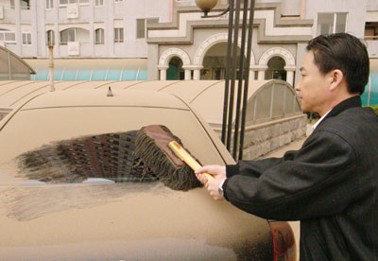
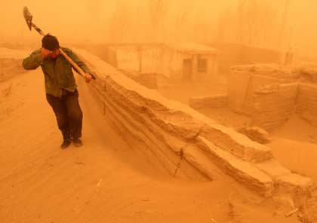
What can you see?
Dust storm!
I can see…
short description of the
scene (e. g. place, event)
2. details (who / what can
you see)
3. impression on the picture
Notes:
Warm up

Slide 16
  Top ten environmental problems
  Acid Rain
  Air Pollution
  Chemical Waste
  Contamination of Marine Habitats
  Deforestation
  6. Diseases
  7. Extinction of Species
  8. Global Climate Change
  9. Overpopulation
  10. Water Quality

Slide 17
  7) What are the common sources of pollution?
  Air pollution： carbon monoxide, sulfur dioxide, nitrogen oxides ，chlorofluorocarbons (CFCs) , ozone and smog
  Light pollution,
  Littering
  Noise pollution,
  Soil contamination
  Radioactive contamination
  Thermal pollution
  Visual pollution
  Water pollution,

Slide 18
  What is environmental protection?
  Environmental protection is a practice of protecting the environment, on individual, organizational or governmental level, for the benefit of the natural environment and (or) humans

Slide 19
  2) What is the Green House effect?
  The greenhouse effect is the rise in temperature that the Earth experiences because certain gases in the atmosphere (water vapor, carbon dioxide, nitrous oxide, and methane, for example) trap energy from the sun. These gases are referred to as greenhouse gases.

Slide 20
  5) What are the harms of the Green House effects?
  What is the global warming?
  (An Inconvenient Truth)
Notes:
8:50-9:58 What is global warming: A traditional explanation:
9:56-11:45 An interesting cartoon clip: show what is global warming? And how to cope with it? An ironic solution?
06:20-7:52 a story about two teachers: what is the purpose of the story
Joke? Lively atmosphere? Ridiculous
Reflect a scientific fact: assumption
What gets us into trouble is not what we don’t know
It’s what we know for sure that just ain’t so.
7:53-8:50
This story leads to another assumption: the topic
The Earth is so big, we can’t possibly have any lasting harmful impact on the Earth’s environment.

Slide 21
  (An Inconvenient Truth) 06:20-7:52
  A story about two teachers: what is the purpose of the story
  Joke? Lively atmosphere? Ridiculous
  Reflect a scientific fact: assumption
  What gets us into trouble is not what we don’t know. It’s what we know for sure that just ain’t so.

Slide 22
  (An Inconvenient Truth) 7:53-8:50
  This story leads to another assumption: the topic
  The Earth is so big, we can’t possibly have any lasting harmful impact on the Earth’s environment.

Slide 23
  (An Inconvenient Truth) 8:50-9:58
  What is global warming: A traditional explanation
  (An Inconvenient Truth) 9:56-11:45
  An interesting cartoon clip: show what is global warming? And how to cope with it? An ironic solution?

Slide 24
  4) What is the sustainable development?
  Sustainable development is a pattern of resource use that aims to meet human needs while preserving the environment so that these needs can be met not only in the present, but also for future generations.
  6) What is ecological balance?
  Ecological balance is to preserve nature, to keep the nature more natural.

Slide 25
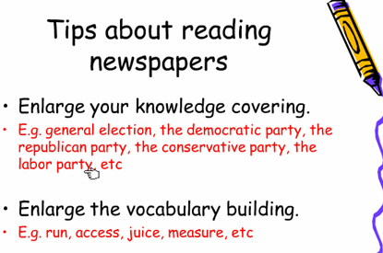

Slide 26
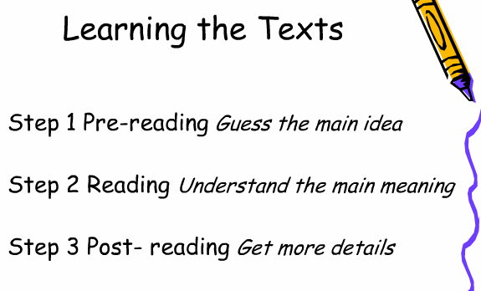

Slide 27
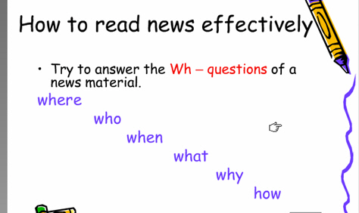

Slide 28
Step 1: Guess the main idea
Analyze the headline:
Ecologists Outline Necessary Actions (for Mitigating and Adapting to a Changing Climate)
Who
What
Why
When: ? Where: ? How: ?

Slide 29
Prediction of Contents：
Is it necessary to mitigate and adapt to a changing climate? If Yes. Why it is necessary?
What kind of actions have been outlined? How to mitigate a changing climate? How to adapt to a changing climate.
Will these actions work?
….

Slide 30
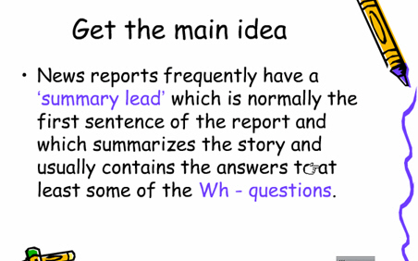

Slide 31
Read the news lead:
1st sentence: Global warming may impair the ability of ecosystems to perform vital services
(Is it necessary to mitigate and adapt to a changing climate? If Yes. Why it is necessary?)
It provides background information about the harm brought by the changing climate.

Slide 32
Read the news lead:
2nd sentence: In a statement released Jan. 26 (when), the Ecological Society of America (ESA) (who) outlines strategies that focus on restoring and maintaining natural ecosystem functions (what) to mitigate and adapt to climate change (why).
It provides more details of some Ws.

Slide 33
Compare the headline and the lead
Ecologists Outline Necessary Actions (for Mitigating and Adapting to a Changing Climate)
In a statement released Jan. 26, the Ecological Society of America (ESA) outlines strategies that focus on restoring and maintaining natural ecosystem functions to mitigate and adapt to climate change.

Slide 34
Step 2: Understand the main meaning
《大学英语课程教学要求》教育部
一般要求：一般题材70词/分钟精读，100词/分钟泛读
较高要求：英语报刊70词/分钟精读，120词/分钟泛读
650 words totally；News body: 600 words: 5-6 minutes
Extensive reading: Get to know the main meaning of major parts of the news.

Slide 35
Structure of the news body
Number all the paragraphs and divide the article to three parts from the third paragraph and summarize their main idea.
Part 1: ______ paragraph ( 3 to ___)
Part 2: ______ paragraph (___ to ___)
Part 3: ______ paragraph (___ to _15__)

Slide 36
Where to put them?
Four approaches to
limiting adverse
effects of
climate change
Four adaptation
strategies
to safeguard
ecosystem services
News?
Quotations to illustrate the
fact of the rising
temperature to emphasize
the importance of these actions.
Notes:
What is the logical order of the these information according to their importance

Slide 37
Quotations to illustrate the fact
4 strategies
4 approaches
Climate
Change
Notes:
The most important the closest to the focus, the least important the farthest to the focus.

Slide 38






Step 3: Get more details
Skimming
1
Focuses of the strategies？
2
Approaches recommended
by ESA?
3
A straightforward way?
4
Four adaptation strategies?
5
Something crucial to both
Environment and public health
Notes:
Pair work and compete for the chance to give answers

Slide 39
About Quotes:
Para 2: Quotes from ESA President to emphasize the importance to take swift actions
Para 13-15: Quotes from ESA Statement and the fact of the rising temperature to emphasize the importance of these actions.
Functions of direct quotes:
Objectivity, factuality…
Notes:
直接引语作用
一、增强新闻真实性和现场感。
二、画龙点睛，彰显人物个性
三、借口说话，表达立场
四、活泼版面，美化新闻。
五、增强传播效果，反映时代特征。

Slide 40
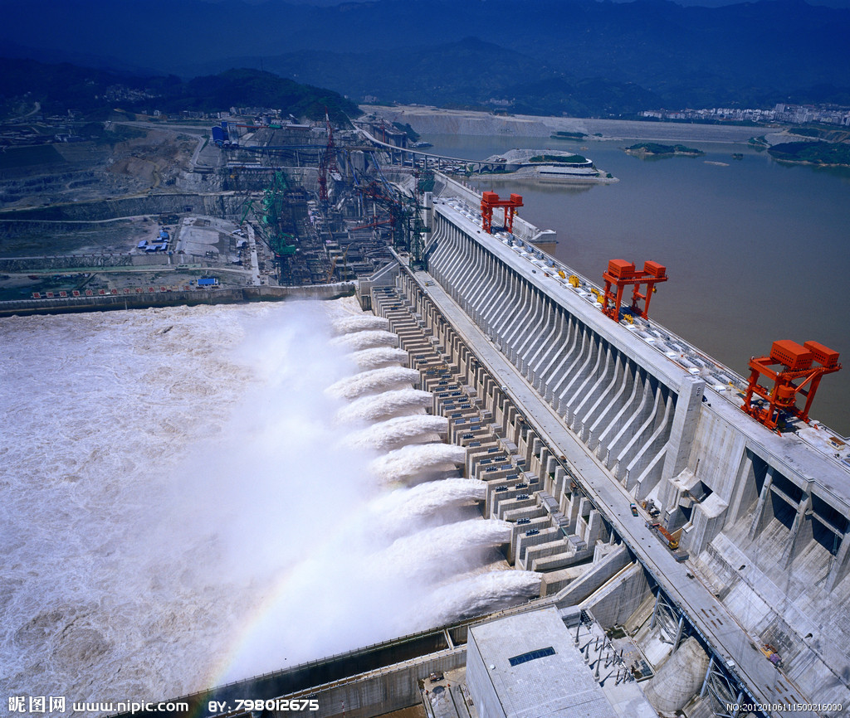
Influence---- Blessing or woe?

Slide 41
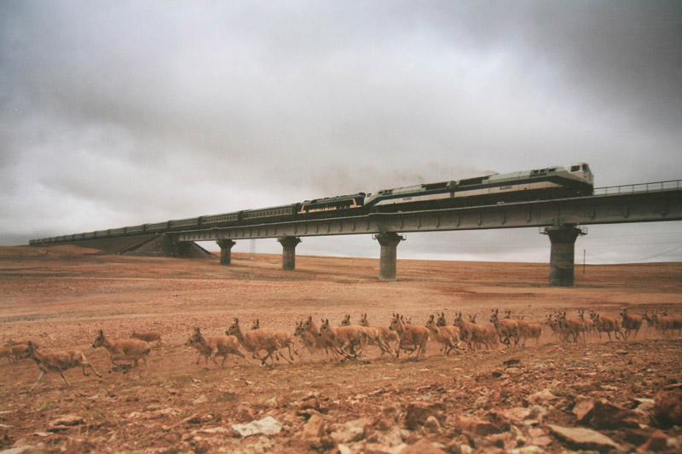
Animal migration on Tibet Plateau

Slide 42
After-reading thoughts and discussions：
Do these actions really work? If yes, how will they work?
After-reading Activity

Slide 43
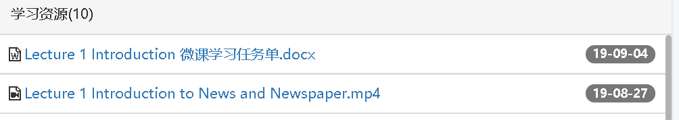
Homework (2):
Read Useful Information Parts Unit 1 about Newspapers (P11-12).
Unit 12 about News Media in Britain (P163-166).
Unit 13 about News Media in the USA (P 177-181).
Watch the short video and finish the “新闻基础知识练习1”on the website.

